Slide 1
useRef()

Slide 2
What is ref ?
Before hooks, ref was used with class components to directly access DOM elements or React elements.
What is useRef ?
useRef is a Hook that returns a mutable ref object whose .current property persists across renders.

Slide 3
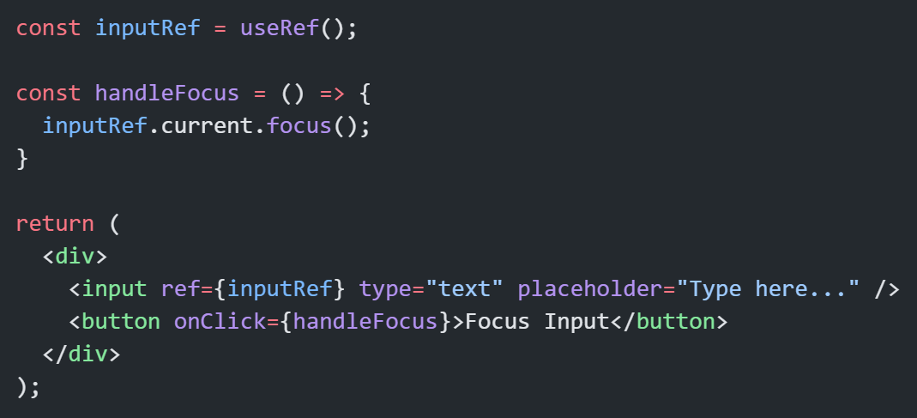
Basic Syntax:
useRef() is like a box you can store anything inside (DOM node, number, object, etc.).
Changes to .current do not cause re-render.
It’s not reactive, but persistent.

Slide 4
Two Main Uses of useRef
Accessing DOM Elements
Storing Mutable Values (Without Re-render)

Slide 5
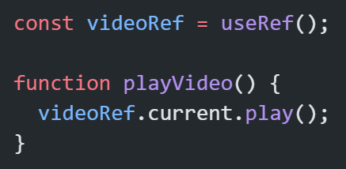
1. Accessing DOM Elements
When you need to directly manipulate a DOM element (e.g., focus, scroll, play video).

Slide 6
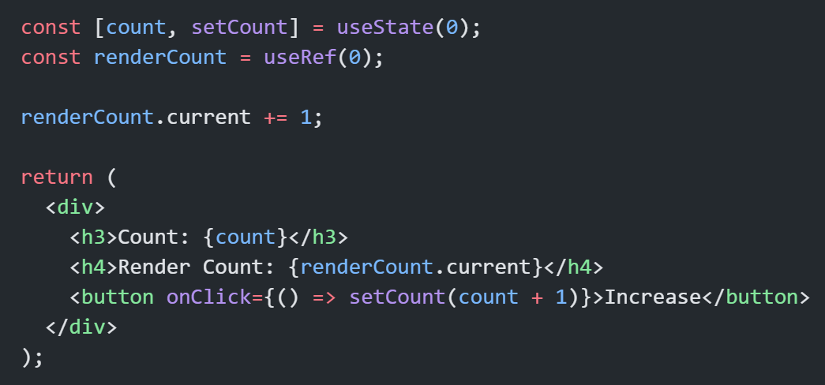
2. Storing Mutable Values (Without Re-render)
Sometimes you want to store data between renders without triggering updates.

Slide 7
Difference between useState and useRef:
Feature | useState | useRef
Triggers re-render on update | ✅ Yes | ❌ No
Persistent between renders | ✅ Yes | ✅ Yes
Common use | Store UI data | Store DOM reference or mutable value

Slide 8
Thank You

